Slide 1
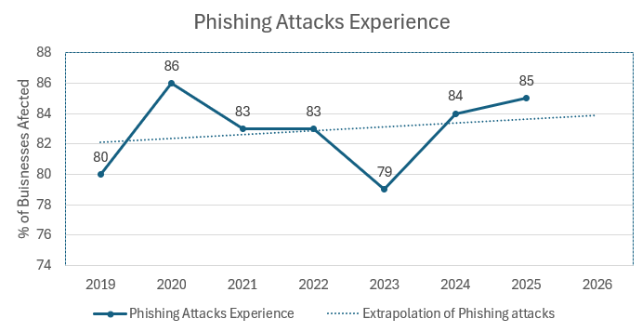
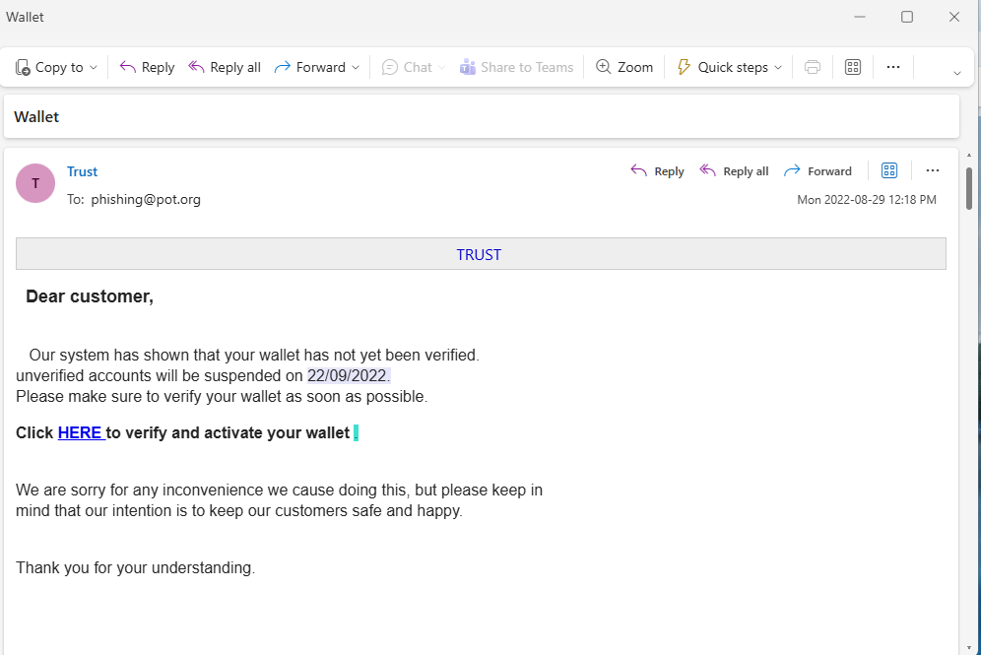




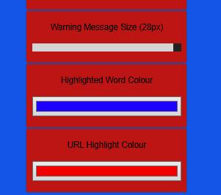
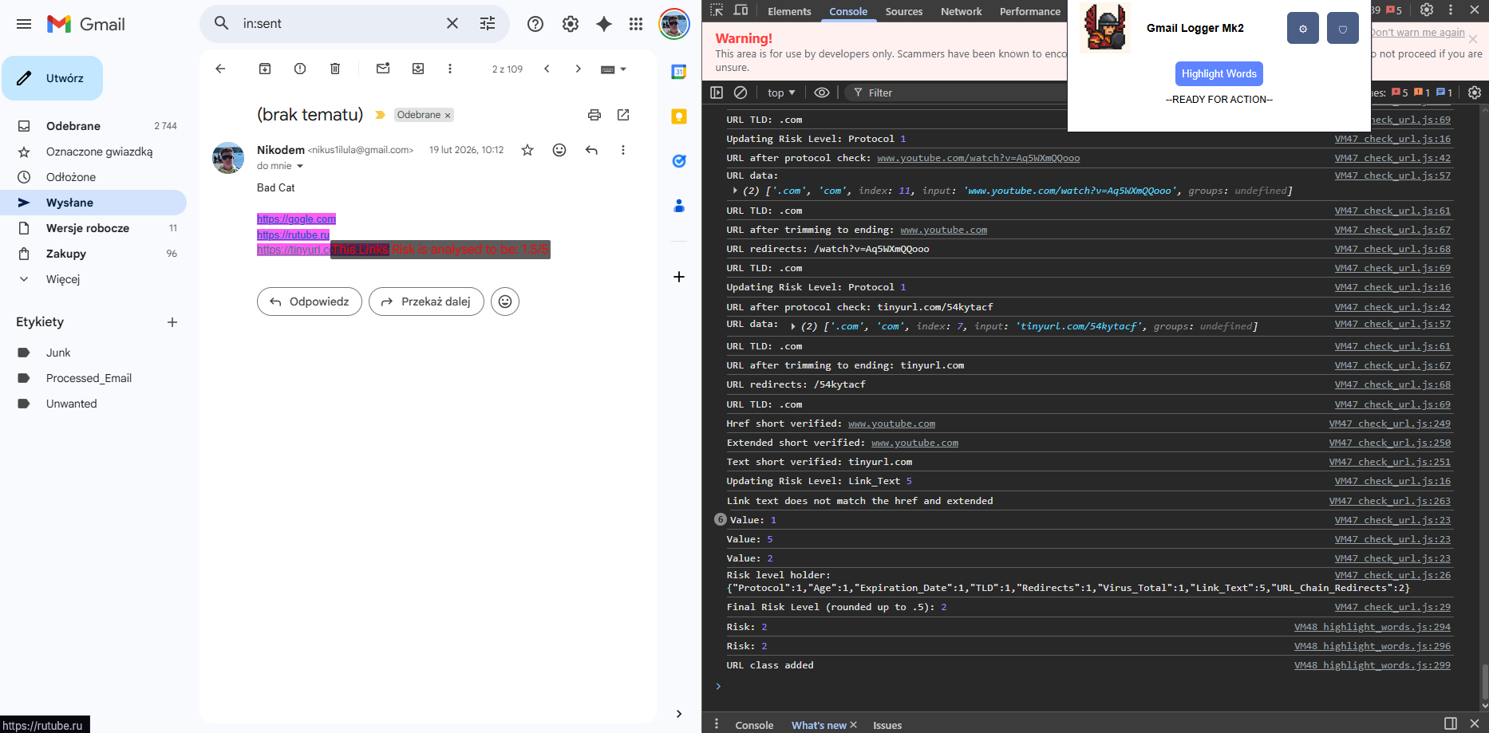
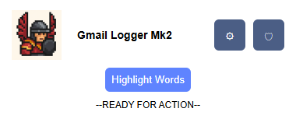

Phish Hussar – Anti Phishing Assistant
Scam Email – How does Phish Hussar Work?
What is it and what does it solve?
Phish Hussar uses a variety of algorithms and databases to calculate the risk of an email. Present the risk information to a user to prevent the possible attack and teach them of the risk posed to them.
Display
Target Market
Users with Email
Users aged 40+ Tech Illiterate
Needing Low-cost software
Language Used
Generic
Fear Educing
Urging
Time Sensitive
Relocating user
Scan and analyse
- CSBS 2019-2025 (Phishing attacks)
Software Deployment
Download Software File
Add file to extensions in browser
Add API keys in software
Modify Settings
Open Gmail and use!
Most Targeted
Ages 21-35
Most Gullible
Ages 35-49
Most Financial Losses
Ages 75+
Link
Where does it lead?
Is it safe?
https\\:goodsite.uk/QstH3fE
Find where it leads to?
WHOIS – provides data regarding registration and hosting of a webpage. Gathered from registrars and registries.
Data from LexisNexis.co.uk & Ons.gov.uk
http\\:badsite.ve/virus.exe
VirusTotal – independent database with a compilation of risk assessments by different companies
Get Risk assessment from VirusTotal
Aims
Compile emails by Phishing and non phishing
Analyse frequency of words in Phishing and Normal emails
Perform Risk assessment based on the difference.
Certain language more present in fishing indicate they are phishing emails
Datasets
Phishing Dataset on Kaggle by Text Analytics
Phisng_Pot dataset by rf-peixoto on GitHub
Phishing Dataset on Keggle by naserabdullahalam
Analyse
Protocol
Domain Name
Extension
Get WHOIS DATA
Website Protocol
Domain name
Path/extensions
Age of website
Certificate
Expiation Date
Virus total score
URL redirects num
Compile analysis and create Risk Score
Analyse
4.Age
5.Certificate
6.Expiration Date
API Backend
MVP Target Metrics
85% <= flagged phishing attempts using test data
Deployable to Beta Users
>= 10% False Positives
English Language
Gmail
User Returned UI
Customisable User Interface Settings
Users with visual impermeant can customise their inviroment
FRONT END
WHOIS
Gmail
Extension
HUSSAR API
Code Base
Chrome Extension
Html
CSS
JS
JSON
API
Python
SQL Lite
Phish Hussar – The Extension
Limitations
English Only
Zero-day phishing website's lower chance of detection
Lack of access to APIs may decrease accuracy
VIRUSTOTAL
Nikodem Drabik

